Slide 1
Purview on Power BI
Liping Huang
26 Jan 2021

Slide 2
Set up
Unlike other data sources, users can only use managed identity to connect to Power BI
In order to set up Power BI, user will need to have Power BI Admin rights
Register and scan a Power BI tenant (preview) - Azure Purview | Microsoft Docs

Slide 3
Assets

Slide 4
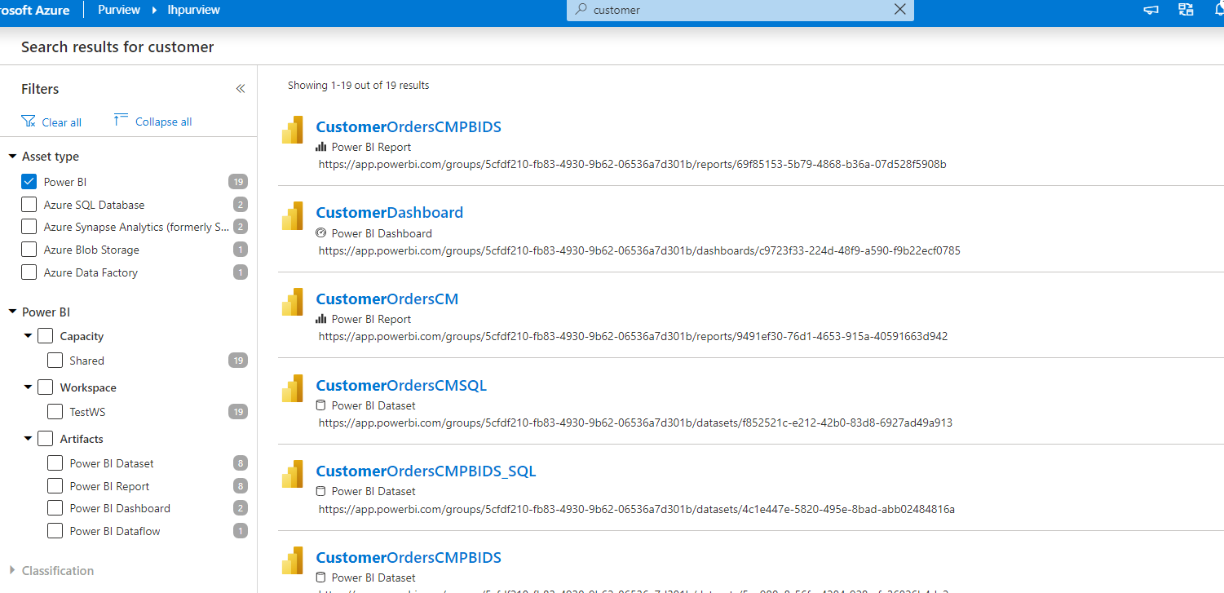
Power BI Artefacts that are scanned
Purview scans the entire Power BI tenant (scanning only parts of the tenant is not possible currently), below artefacts are scanned
Power BI Datasets
Power BI Reports
Power BI Dashboards
Power BI Dataflows
Users can filter search results by Power BI Capacity Type, Workspace Name and Artefact Type

Slide 5
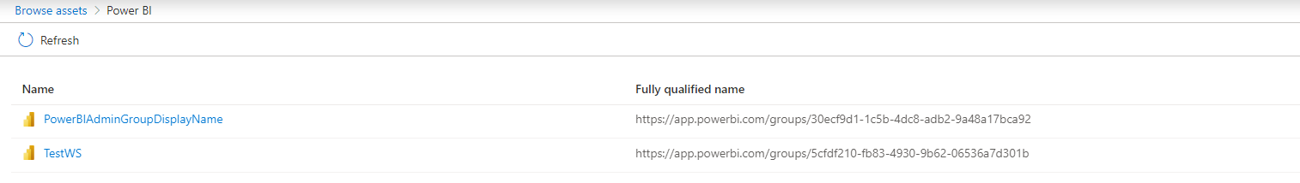
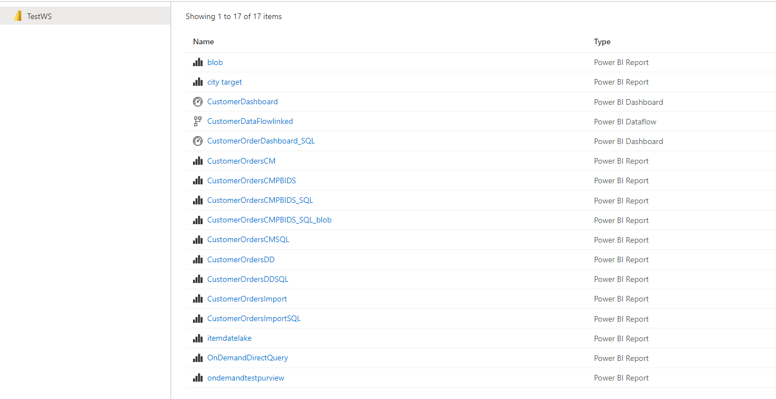
Browsing Power BI Assets
When Browsing Power BI assets, all workspaces scanned will be listed
When clicking into a workspace, all scanned assets and their types will be listed

Slide 6
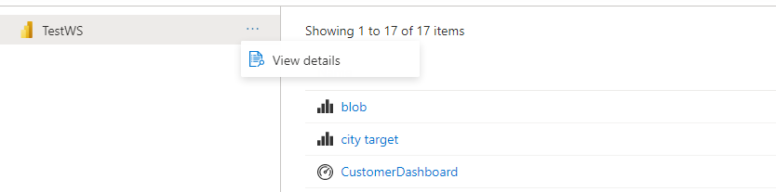
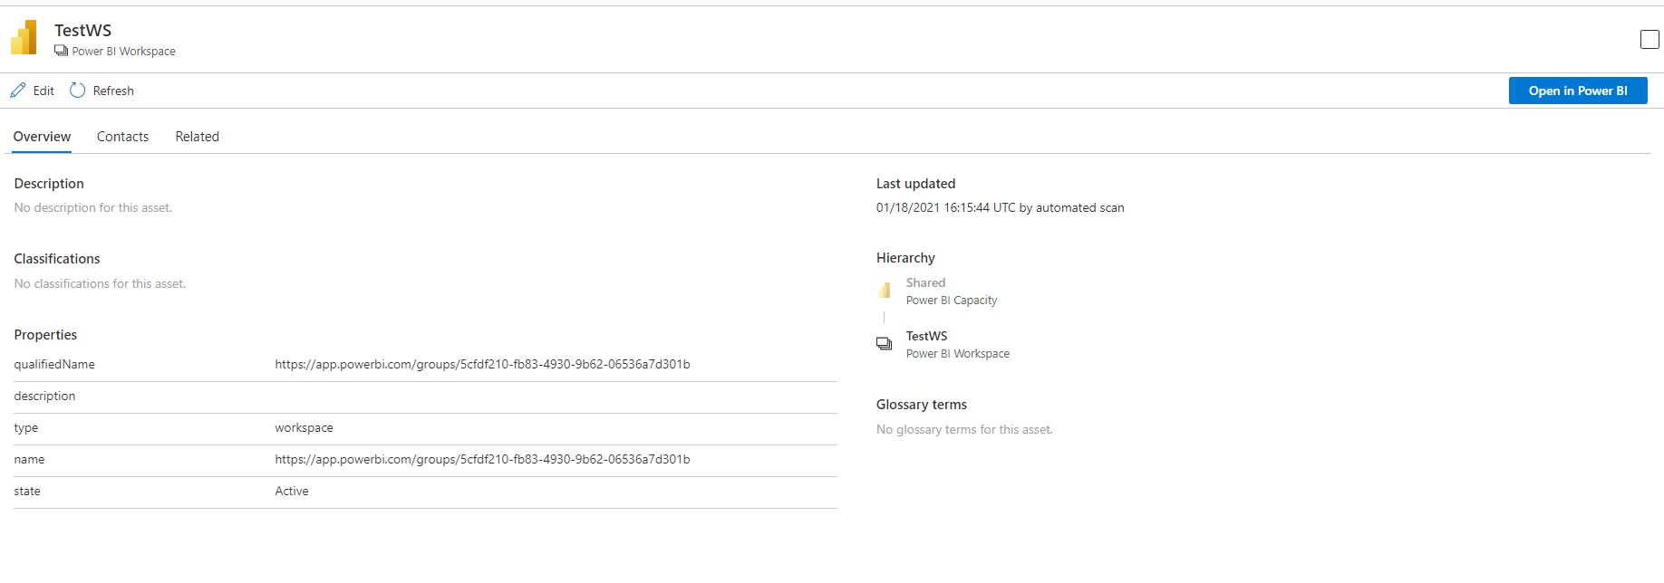
Workspace
User can click to view details on the workspace
Below information are shown for workspace overview, hierarchy is capacity/workspace

Slide 7
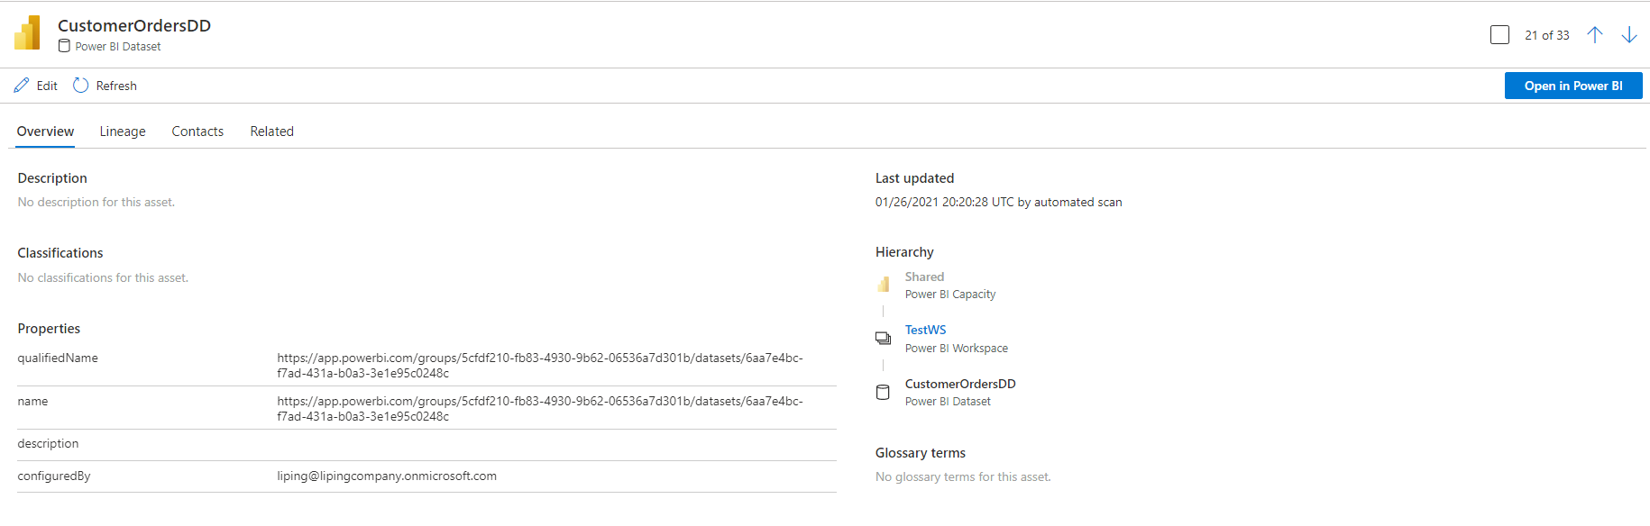
Datasets
As drilldown to table level is not supported currently, there is no schema tab available for datasets
Hierarchy is capacity/workspace/dataset
Users have the option to open asset in Power BI

Slide 8
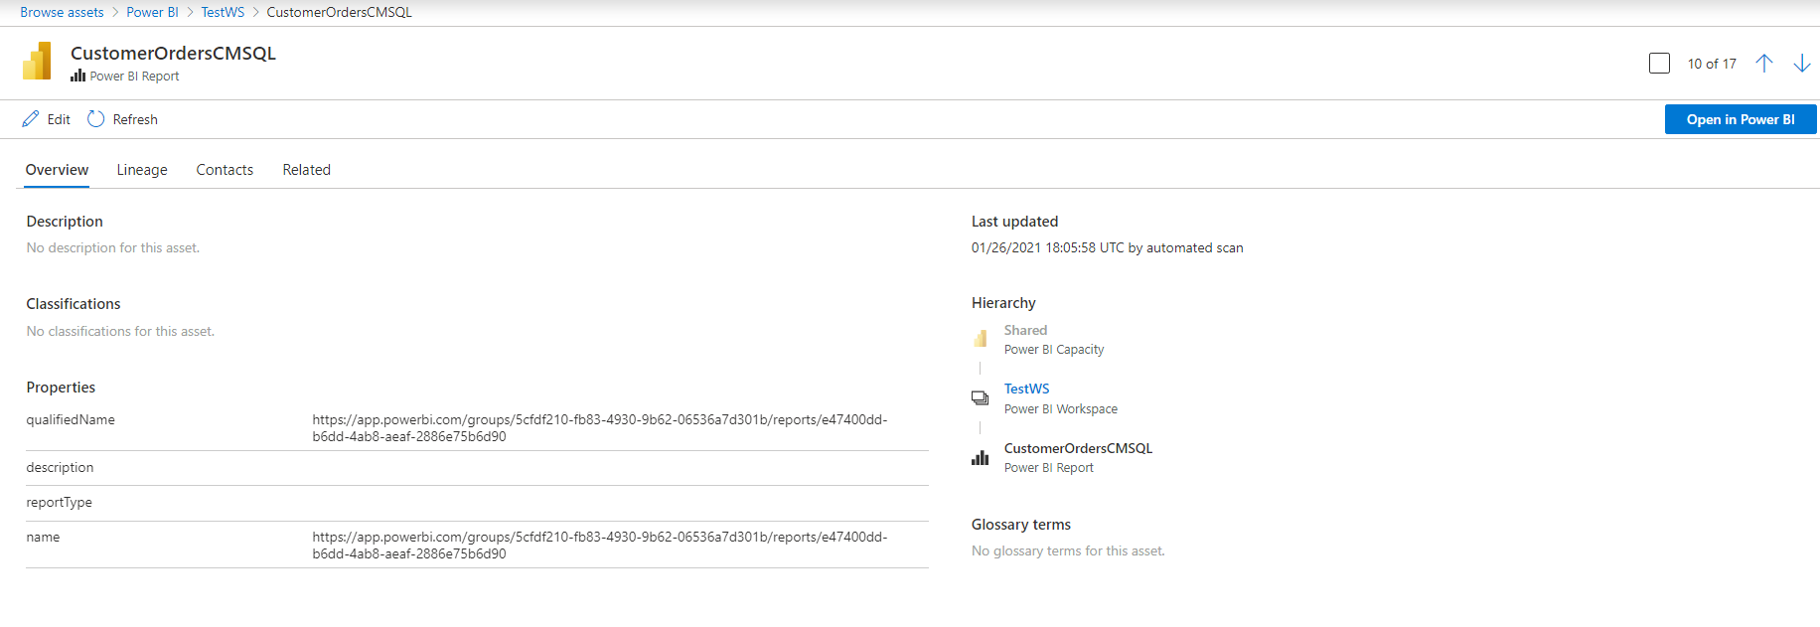
Reports
Hierarchy is capacity/workspace/report
Users have the option to open asset in Power BI

Slide 9
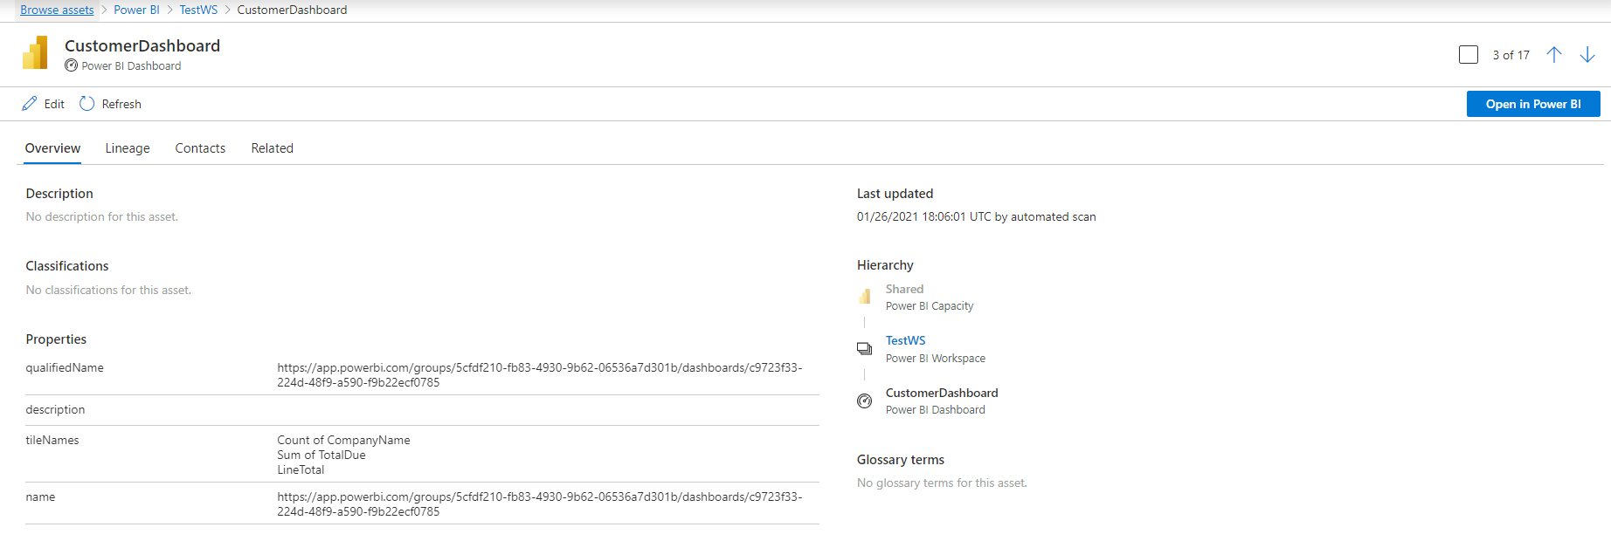
Dashboards
Tiles names are shown for dashboards
Hierarchy is capacity/workspace/dashboard
Users have the option to open asset in Power BI

Slide 10
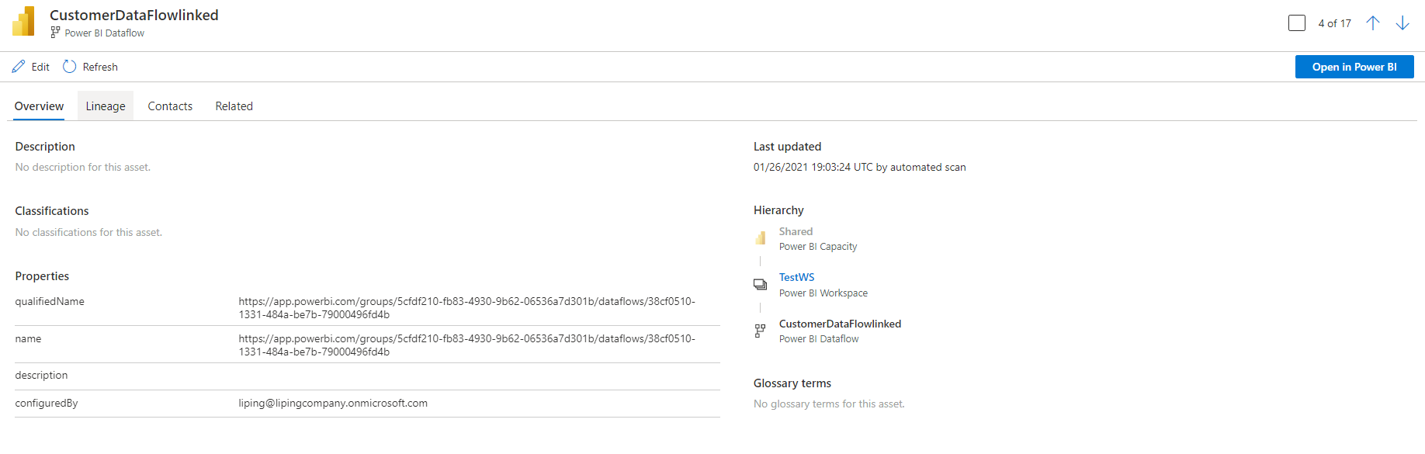
Dataflows
As drilldown to table/entity level is not supported currently, there is no schema tab available for dataflows
Hierarchy is capacity/workspace/dataflow
Users have the option to open asset in Power BI

Slide 11
Lineage

Slide 12
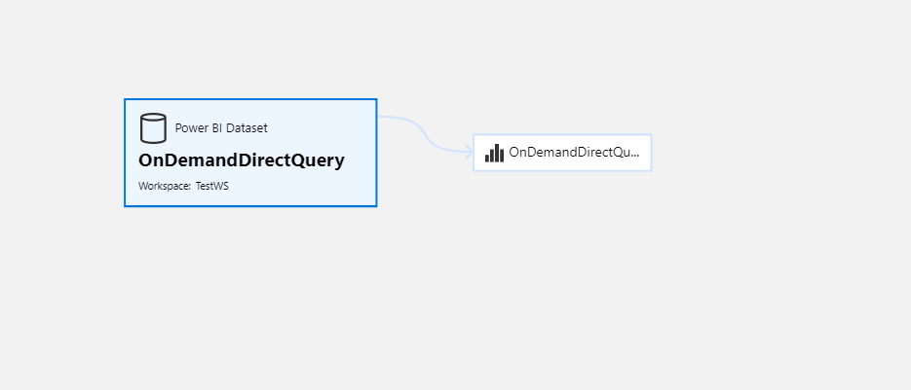
Synapse Serverless
When connected to Synapse Serverless Form Factor (Import or Direct Query) the lineage is only shown for Power BI, because views created by Serverless Form Factor are not scanned in Purview

Slide 13
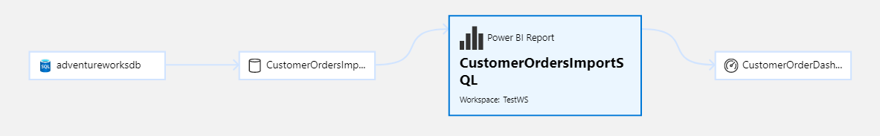
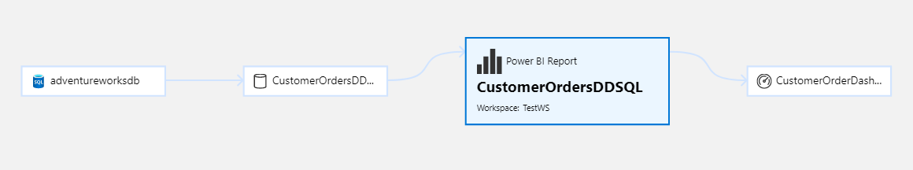
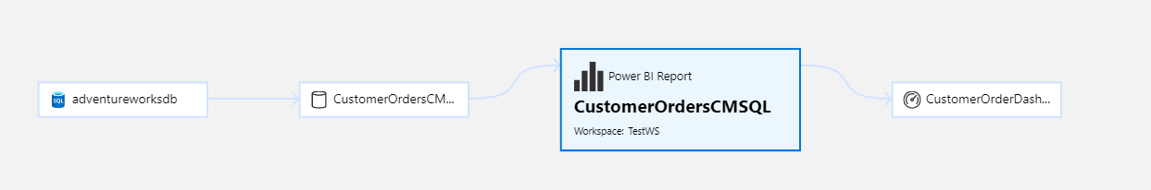
Storage Mode
Storage mode (Import, Direct Query, Composite Model) does NOT affect lineage

Slide 14
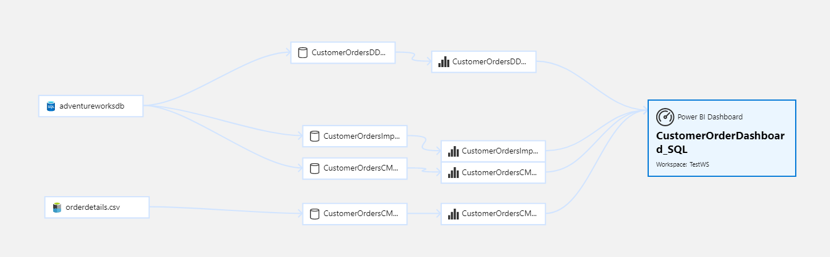
Dashboard
Dashboard will show lineage for all tiles within the dashboard

Slide 15
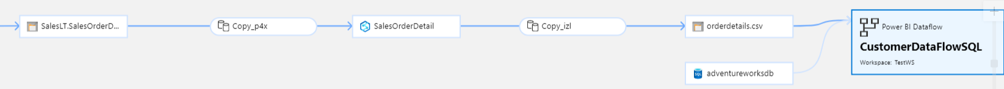
Dataflow
Dataflow works just as other assets in Power BI will pick up lineage from previous steps.

Slide 16
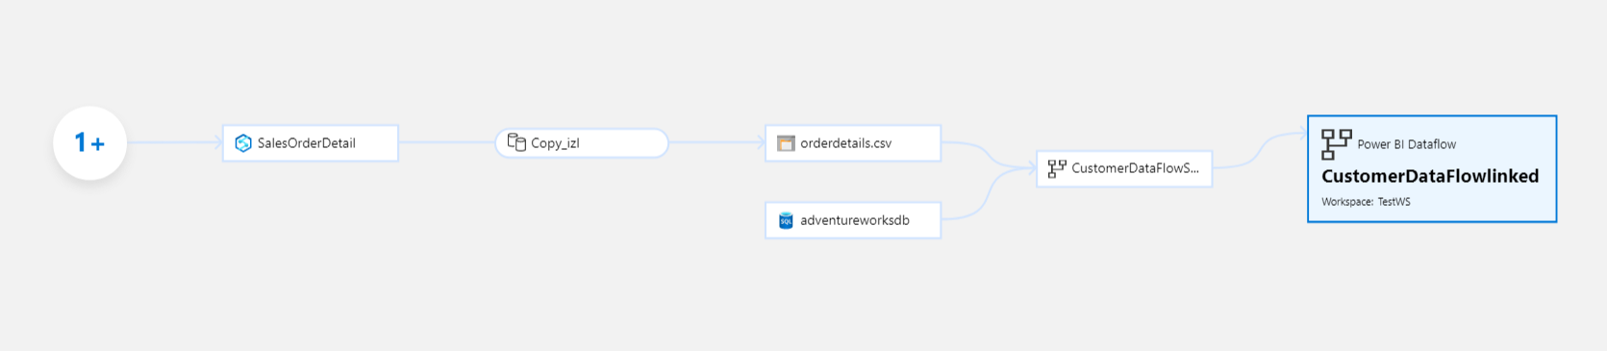
Linked Dataflows
Lineage works for linked dataflows

Slide 17
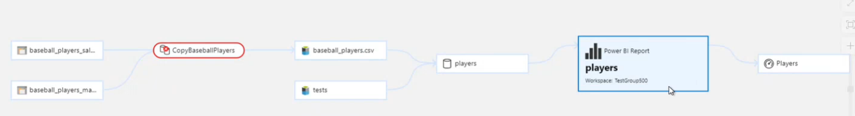
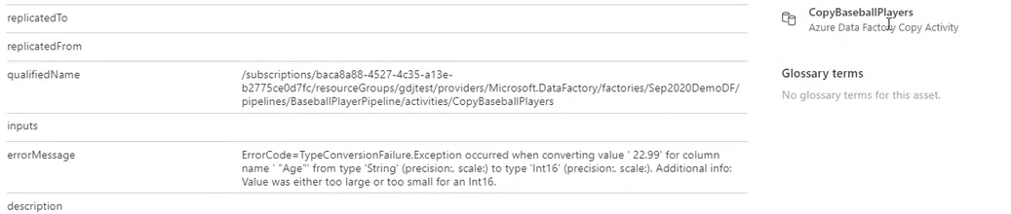
Root Cause Analysis
Lineage can help root cause for possible failure upstream in the workflow.
Click on failed copy activity, switch to asset, error code will show in overview, contact expert or owner or open in ADF

Slide 18
Limitations
Currently scan is for the entire Power BI tenant, scanning only certain workspaces or capacity is not supported
Currently only one scan is allowed for Power BI, as opposed to in other data sources different scans can be set up with different rulesets.
Can re-run the same scan multiple times,.
During Public Preview, there is no capability to drill down to table or column level with Power BI Assets. Impact analysis on columns will be available in Power BI for GA.
Incremental scan for Power BI is not available currently.
Power BI Apps are not scanned currently.
Scanning Deployment pipeline in Power BI is not supported currently

